Slide 1

Is ChatGPT ethical?
By
Rezwan Karim
Abdullah Al Mahi
Zahra Hossain
Mohammad Nuaiman

Slide 2
Introduction to ChatGPT
Big language model ChatGPT, an AI (artificial intelligence) tool from OpenAI is based on the GPT (Generative Pre-trained Transformer) design
A sizable dataset of roughly 45 terabytes of text material, which included books, journals, and web pages, was used to train ChatGPT.
Customer support, language translation, and chatbots for websites and social networking sites are just a few of the uses for ChatGPT.

Slide 3
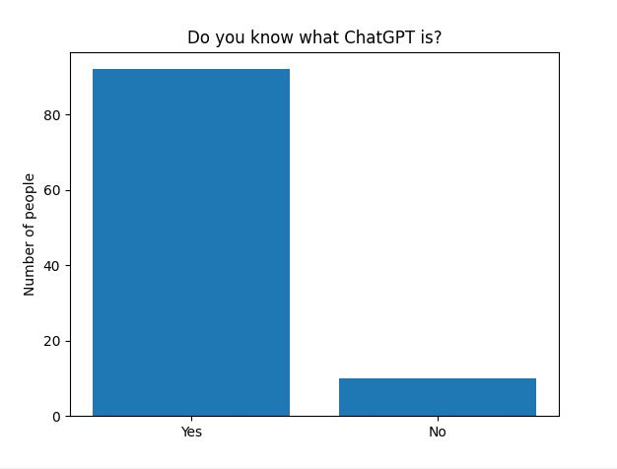
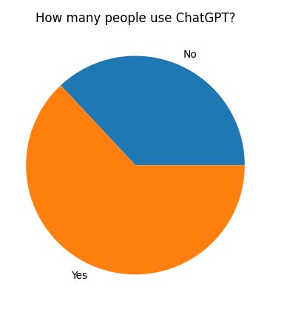
People on if they know and use ChatGPT

Slide 4
Collection of data using a survey
A survey was taken from a total of 102 people, almost all of them being undergraduate students, from academia within a period of 20 days to measure opinion about the use of ChatGPT by students and whether universities should allow it or not.
The survey was online from March 5th to March 25th where 92 people stated they knew what ChatGPT is.

Slide 5
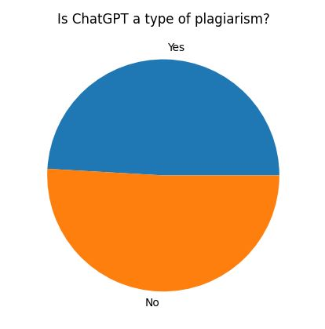
IS ChatGPT a type of plagiarism?
Out of 103 people, 54 people say that ChatGPT is plagiarism in and of itself. The reason for which people think it is plagiarism is that ChatGPT is a LLM technology, which gathers large amount of information and generate outputs, so when someone relies on it when they write reports, they are indirectly using knowledge of other people.

Slide 6
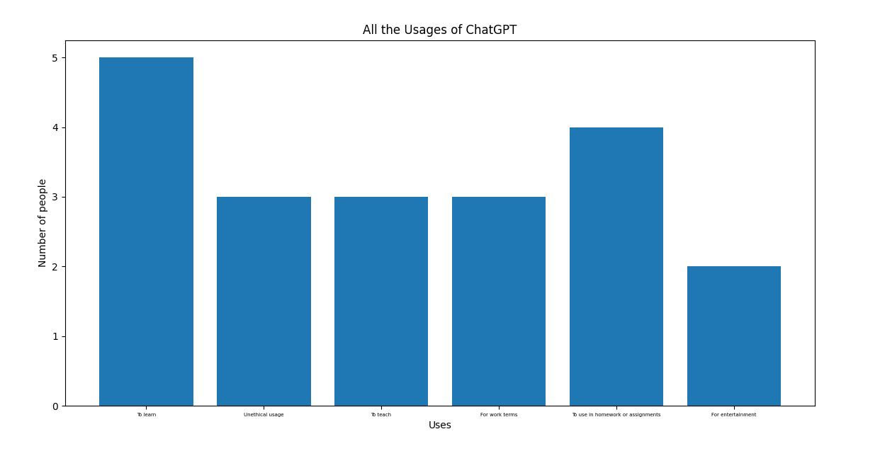
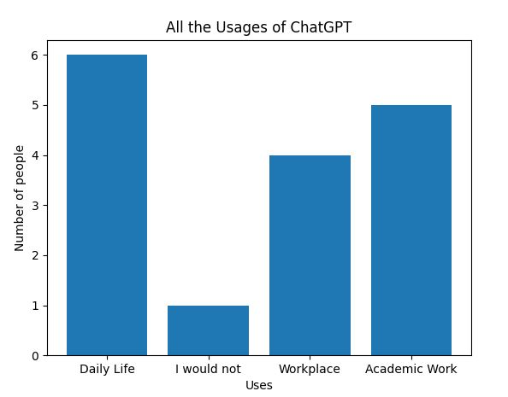
Some uses of ChatGPT by students

Slide 7
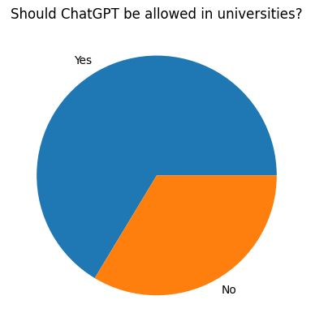
Should ChatGPT be allowed in universities?
Out of the 102 people who did the survey, 73 state that ChatGPT should be allowed in universities. There is a clear imbalance between the two opinions. The result of the survey indicates that on a scale of 5, people on average think tools like ChatGPT inhibit education at a factor of 3. The reason for which people primarily think that ChatGPT should be allowed in university might be that even though responses generated by ChatGPT can be incorrect and may include bias, it is an opportunity to bring out more ideas in a relatively short period of time.

Slide 8
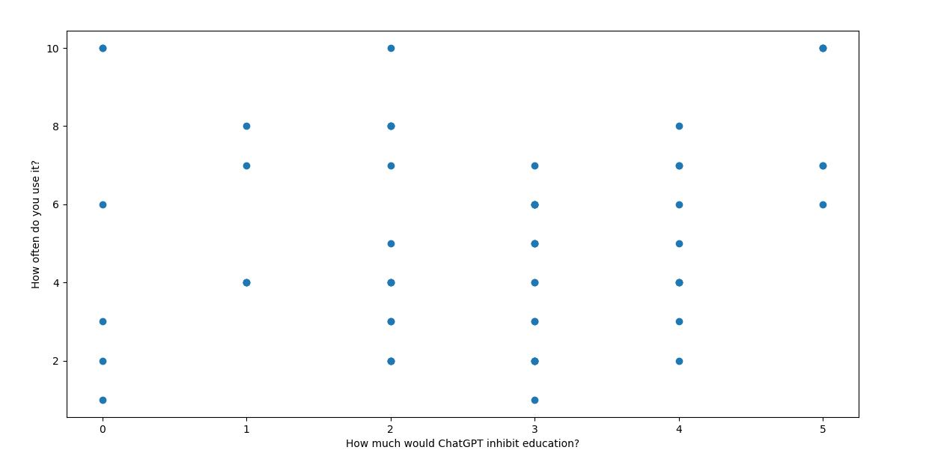
Does ChatGPT inhibit education?
when plotting the graph of people’s usage frequency and their opinion on whether ChatGPT inhibits education, it can be shown that many of the people who do not use ChatGPT think ChatGPT moderately inhibits education.

Slide 9
Benefits of ChatGPT
ChatGPT provides a number of advantages, including:
1. Increased Efficiency: ChatGPT may help with customer service by answering questions quickly and effectively, freeing up human customer service professionals for more difficult work.
2. Consistency: ChatGPT may respond to client enquiries in a consistent manner, ensuring that consumers receive correct information and decreasing the possibility of human mistake.
3. Availability 24 hours a day, 7 days a week: ChatGPT can assist consumers at any time of day or night, even when human personnel are not accessible.

Slide 10
Nevertheless, there are certain drawbacks to utilising ChatGPT:
1. Emotional Intelligence Deficit: ChatGPT may struggle to understand and respond correctly to complicated emotional circumstances, such as an unhappy or irate customer.
2. ChatGPT may struggle to comprehend the intricacies of a customer's enquiry and may respond with a generic response that does not completely satisfy the customer's demands.
3. Data Dependence: The capacity of ChatGPT to produce correct replies is contingent on the quality and quantity of data on which it has been trained. Incorrect replies might result from faulty or missing data.
4. Thus, while ChatGPT can be a beneficial tool for customer support, it is critical to know its limits and utilize it in tandem with human agents to deliver the best service possible.

Slide 11
Future of ChatGPT
ChatGPT has a huge potential to influence how education is provided in the future. ChatGPT, a language model built on the GPT-3.5 design, has never been better at comprehending and responding to human language. This means that in the future, ChatGPT can act as a smart tutor, providing students with clear explanations and comments in a manner that feels conversational and natural. Additionally, ChatGPT can examine pupil feedback and modify its teaching strategies to better fit different learning preferences. Moreover, ChatGPT will only become more sophisticated and capable of addressing the needs of a broad range of learners as technology continues to advance. Besides that, ChatGPT has the power to personalize and transform education, changing how pupils learn and get ready for the future. Finally, the survey results indicate that use of tools like ChatGPT would be more frequent, even by current nonusers

Slide 12
Conclusion
In conclusion, the use of ChatGPT by pupils has recently generated a lot of discussion. Others contend that it might encourage academic dishonesty and jeopardize the integrity of the educational system, despite some who claim it can be a useful learning tool that can improve students' comprehension of various subjects. While ChatGPT can be a valuable tool for students, it is important to use it responsibly and ethically.

